Slide 1
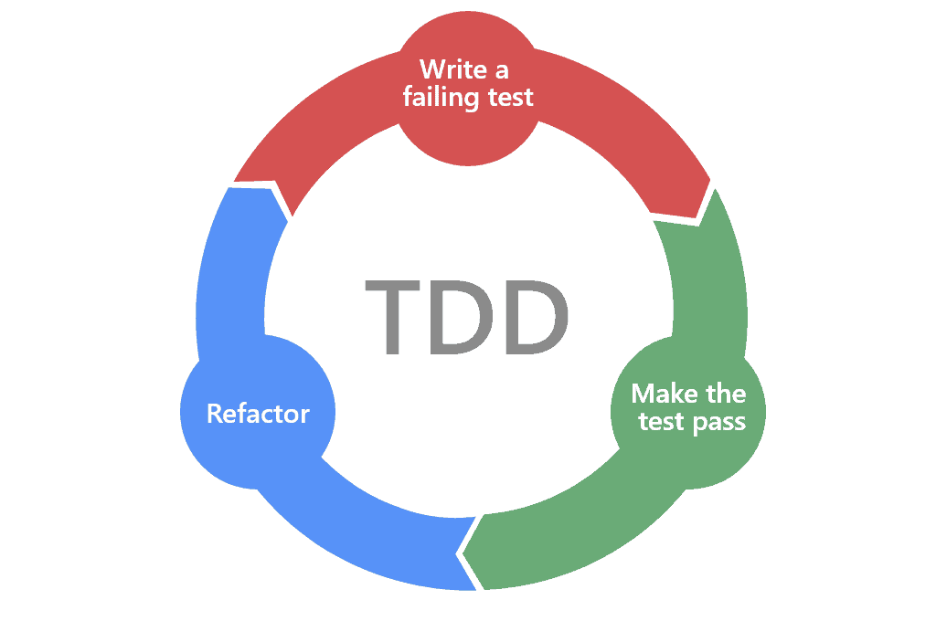
Notes:
Herzlich Wilkommen und cool dass ihr da seid, ich bin..
Wer sich bereits mit dem Thema beschäftigt hat, kennt diese Grafik evtl, wer nicht ist auch nicht schlimm, ich erkläre das ohne Benötigtes Vorwissen.
Worum geht es bei TDD? Wir fangen oben an, schreiben einen fehlschagenden Test, machen dass es funktioniert, machen dass es schön aussieht und dann geht’s wieder von vorne los.
Klingt cool oder? Gibt wahrscheinlich aber ein paar Fragen, und ich hoffe dass ich die während dieser Präsentation lösen kann.
Wenn ihr fragen habt, meldet euch, ich nehme euch dran sobald ich fertig mit der Folie bin.

Slide 2
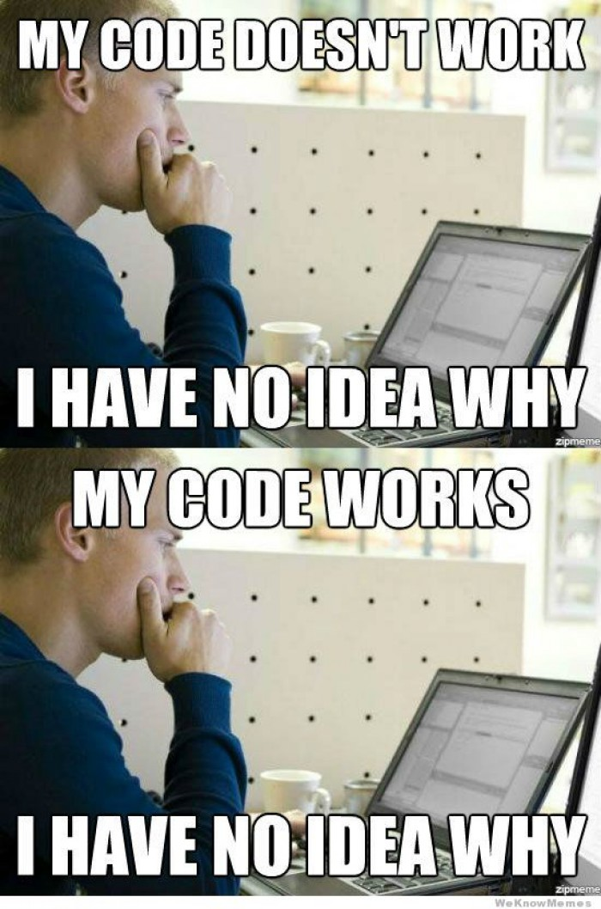
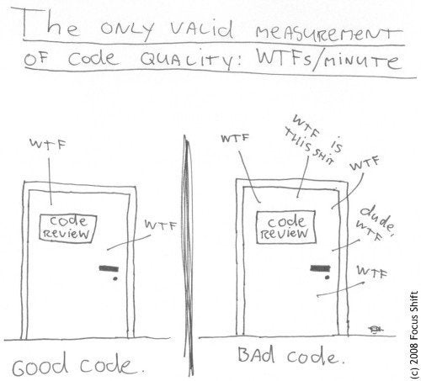
Motivation

Slide 3
Disclaimer
TDD is hard and needs time invested.
Take it step by step ☺

Slide 4
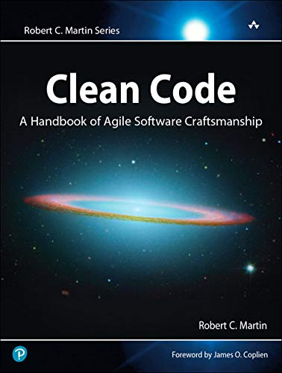
Clean Code
Clean Code is intuitively understandable text
Not necessarily code, can be YAML, DBs, etc..
80% of the life cycle of a project is maintenance, feature expansion and bug fixing.
It’s not easy and requires experience.
This experience can be learned by doing.

Slide 5
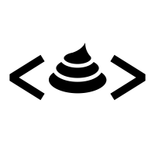
Code Smells
“What? How can code ‘smell’? - Well it doesn’t have a nose… but it definitely can stink!” - refactoring.guru
Code Smells are patterns that make code less readable.

Slide 6
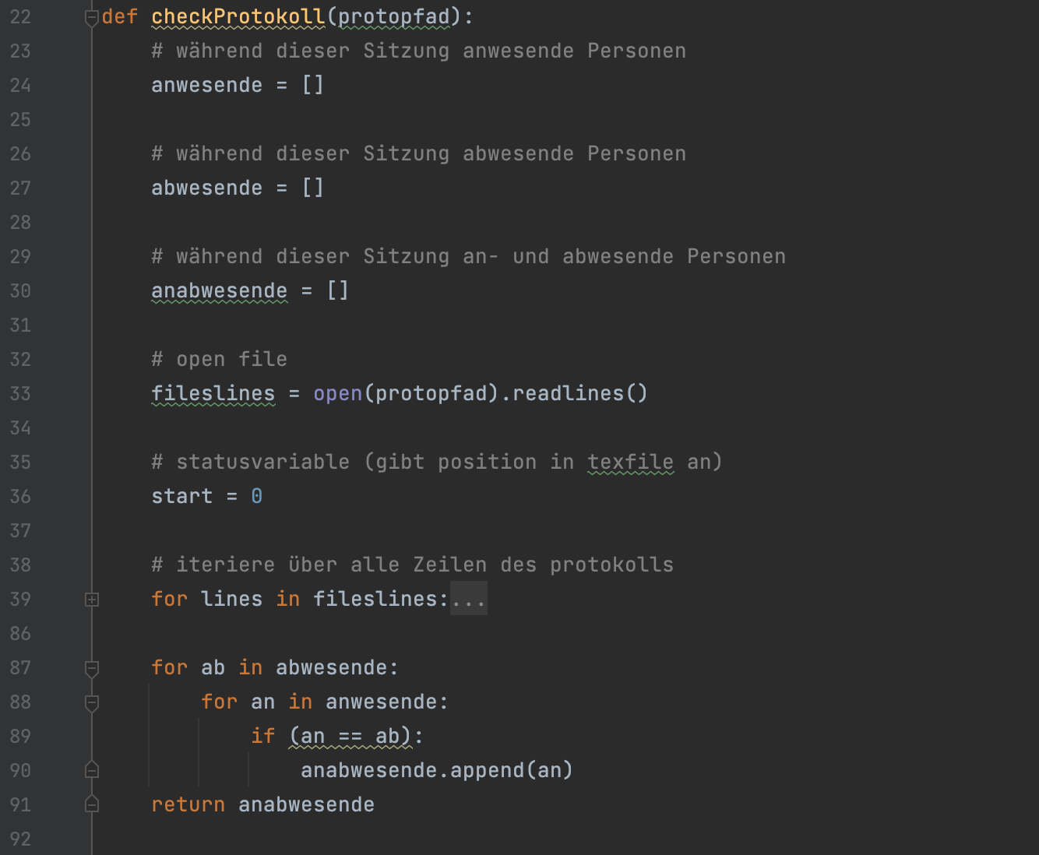

Slide 7
What happens when I don’t give a shit? My boss said it has to be done yesterday.
Cumulative
Functionality
Good code
Bad code
Payoff point
(appears in weeks, not months)
Time

Slide 8
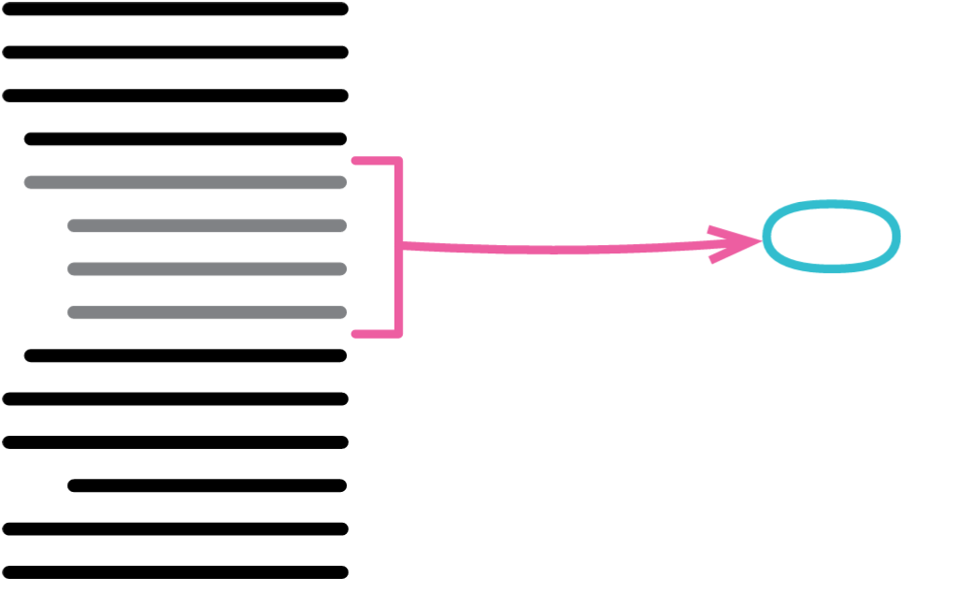
Refactoring
A refactoring is a structure changing, behaviour preserving process.
Notes:
Wie mache ich doofen Code wieder gut? Jeder wird mal doofen Code schreiben, und das ist OK. Denn ich habe die Lösung.
Mit Refactorings kann man jederzeit seinen Code umstrukturieren. Eine Struktur die gestern Sinn ergeben hat, muss dies heute nicht tun.
Vieles geht mittlerweile automatisch (z.B. extract method, inline variable / method, flip conditionals)

Slide 9
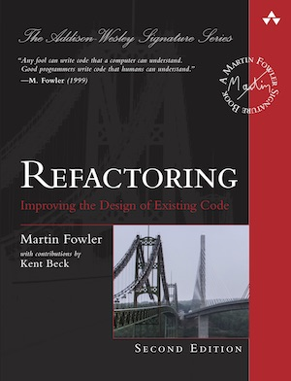
Further Resources Clean Code, Code Smells & Refactorings
https://refactoring.guru

Slide 10
TDD
The idea of TDD is to convert requirements to test cases and force the requirements to be fulfilled by writing the tests first.
Two approaches
Chicago / Detroit TDD (bottom up)
London TDD (top down)
Notes:
Explain London without Mocks

Slide 11
Process
Do not write more than necessary to make the test pass
If you don’t know what to implement next, look at the user story prioritization (what is the next most important thing to do?)
Plan ahead and break the tasks up if necessary.
Notes:
Motivation to 1
Explain user story prio

Slide 12
Rules
Do not write production code that is more specific than the tests.
Tests makes the test suite more specific.
Production code makes the production app more general.
Don’t go for the goal. Avoid the central behaviour as long as possible.
Do not bring TDD to work if you’re not good at TDD.
Trying to improve code by writing tests is never wrong. Just don’t force your team until you’re sure of what you’re doing.

Slide 13
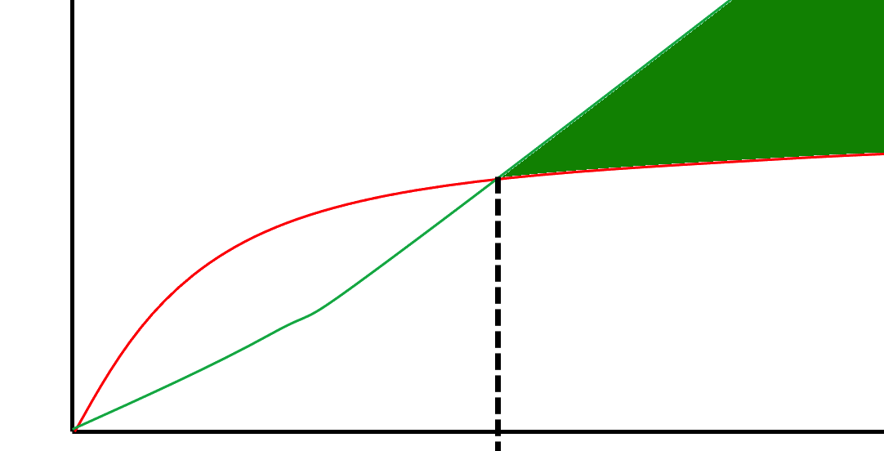
Effects
💯% Test coverage
If you break something, you’ll know it.
More modular projects
Examples of how to use code snippets
These all should (in theory) result in faster development speed later in the development cycle

Slide 14
When not to do
If you’re in a professional setting and you’re not an expert.
If you’re doing teamwork and you’re not an expert.
Otherwise? Go for it.

Slide 15
How to write good Tests

Slide 16
Differentiate between Integration and Unit Tests

Slide 17
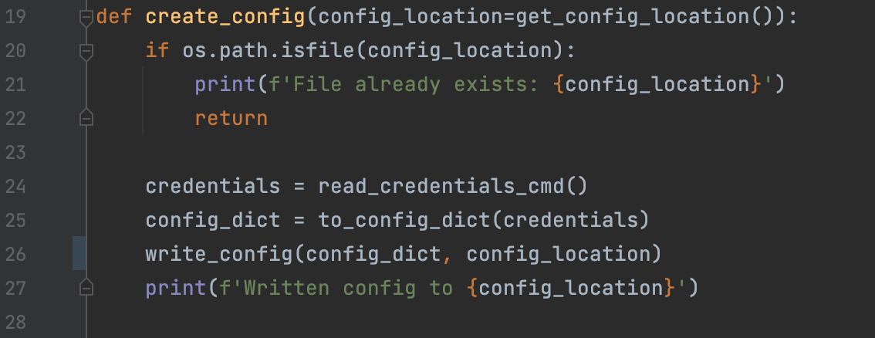
Isolate the Testable Logic
Mock with Dependency Injection
Patch & Mock

Slide 18
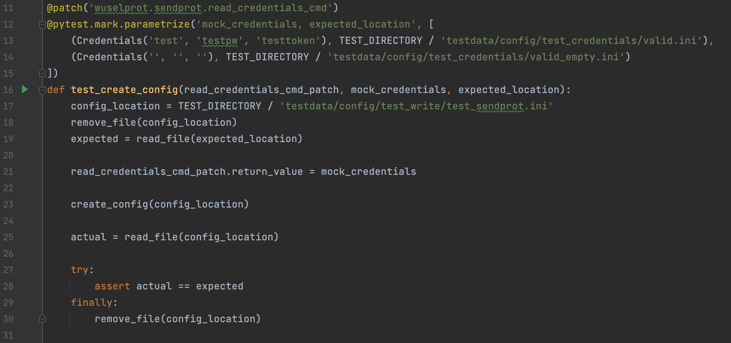
Follow Arrange, Act, Assert

Slide 19
Follow Arrange, Act, Assert

Slide 20
Helpful Testing Resources
JUnit and Unit Testing Frameworks for other languages
Mocking
Spoof the behaviour of another object with hard coded values
Some Modules have built in mocking solutions
Python e.g. request -> response
Dependency Injection
Method patching

Slide 21
Dependency Injection

Slide 22
Dependency Injection

Slide 23
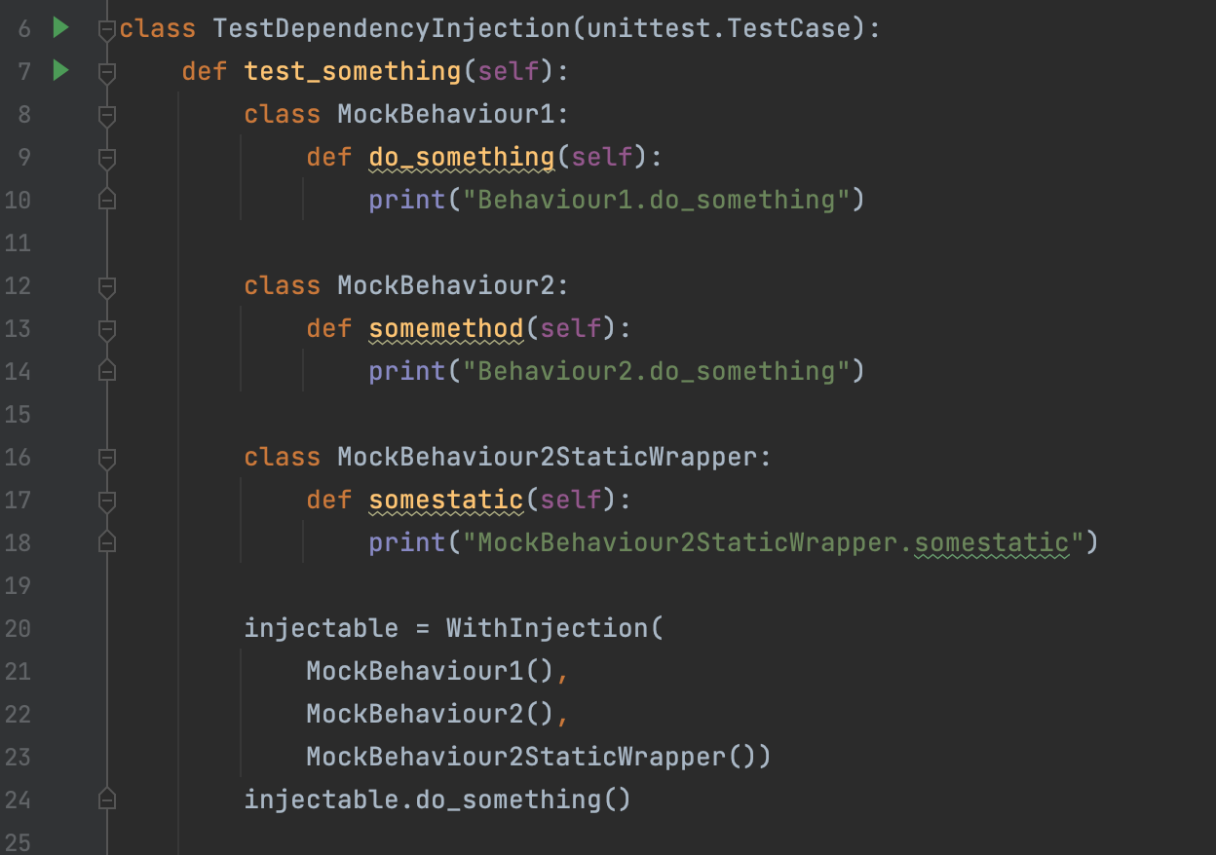

Slide 24
Exercises
2 Minute TDD
Katas
Program a calculator
Program a calculator that uses strings (terms) as inputs
A program that converts ints to roman numerals
A program that converts roman numerals to ints
Refactoring Katas
Great to learn how to write tests in an existing code base without tests

Slide 25
Other Remarks
Don’t write efficient code. Write code that is maintainable and then make it efficient.
Unreadable code has probably more bugs than readable code, which can influence software security by creating exploitable vulnerabilities.
Bugs are easier to identify in readable code than unreadable code.
Bugs are also easier to fix in maintainable code.
Therefore, readable and maintainable code is usually more secure.
Only applies to code level bugs!

Slide 26
References
https://github.com/testdouble/contributing-tests/wiki/
https://tdd.mooc.fi/
https://tddmanifesto.com/exercises/
https://refactoring.guru/

Slide 27
Cool Books
The important ones
Refactoring: Improving the design of existing code https://www.informit.com/store/refactoring-improving-the-design-of-existing-code-9780134757711
Test Driven Development by Examplehttps://www.informit.com/store/test-driven-development-by-example-9780321146533
Clean Code https://www.amazon.de/-/en/Robert-Martin/dp/0132350882
Other cool books
https://www.informit.com/store/xunit-test-patterns-refactoring-test-code-9780132800051
https://www.informit.com/store/atdd-by-example-a-practical-guide-to-acceptance-test-9780132763233
https://www.informit.com/store/growing-object-oriented-software-guided-by-tests-9780321503626
https://www.informit.com/store/developer-testing-building-quality-into-software-9780134291062#

